Slide 1
WQD7007 Big Data Management
Hive

Slide 2
Agenda
WQD7007 Big Data Management
Hive - easy data extraction, transformation and loading (ETL).

Slide 3
Hive
WQD7007 Big Data Management
Hive is an SQL like query language that enables those analysts familiar with SQL to run queries on large volumes of data.
a dialect of SQL (Hive QL) that focuses on analytics and presents a rich set of SQL semantics e.g. OLAP functions, sub-queries, and common table expressions.
has three main functions:
data summarization,
query, and
analysis.
Data analysts use Hive to explore, structure and analyze that data, then turn it into business insights

Slide 4
Hive
WQD7007 Big Data Management
Hive also allows programmers familiar with the MapReduce framework to plug in their custom mappers and reducers to perform more sophisticated analysis that may not be supported by the built-in capabilities of the language.
Hive users have a choice of 3 runtimes when executing SQL queries. Users can choose between Apache Hadoop MapReduce, Apache Tez or Apache Spark frameworks as their execution backend.

Slide 5
Hive
WQD7007 Big Data Management
FEATURE | DESCRIPTION
Familiar | Query data with a SQL-based language
Fast | Interactive response times, even over huge datasets
Scalable and Extensible | As data variety and volume grows, more commodity machines can be added, without a corresponding reduction in performance

Slide 6
Hive
WQD7007 Big Data Management
The tables in Hive are similar to tables in a relational database, and data units are organized in a taxonomy from larger to more granular units.
Databases are comprised of tables, which are made up of partitions.
Within a particular database, data in the tables is serialized and each table has a corresponding Hadoop Distributed File System (HDFS) directory.
Each table can be sub-divided into partitions that determine how data is distributed within sub-directories of the table directory. Data within partitions can be further broken down into buckets.

Slide 7
Hive
WQD7007 Big Data Management
HCatalog is a component of Hive.
a table and storage management layer for Hadoop that enables users with different data processing tools (including Pig and MapReduce)
more easily read and write data on the grid.
It holds a set of files paths and metadata about data in a Hadoop cluster.
This allows scripts, MapReduce and Tez, jobs to be decoupled from data location and metadata like the schema.
Additionally, since HCatalog also supports tools like Hive and Pig, the location and metadata can be shared between tools.

Slide 8
Hive
WQD7007 Big Data Management
WebHCat provides a service that you can use to run Hadoop MapReduce (or YARN), Pig, Hive jobs or perform Hive metadata operations using an HTTP (REST style) interface.

Slide 9
Apache Tez
Hive
WQD7007 Big Data Management
Apache Tez is an extensible framework for building high performance batch and interactive data processing applications, coordinated by YARN in Apache Hadoop.
Tez improves the MapReduce paradigm by dramatically improving its speed, while maintaining MapReduce’s ability to scale to petabytes of data.
Important Hadoop ecosystem projects like Apache Hive and Apache Pig use Apache Tez, as do a growing number of third party data access applications developed for the broader Hadoop ecosystem.

Slide 10
Hive without and with Tez
Hive
WQD7007 Big Data Management

Slide 12
Online reference
http://www.javachain.com/hive-crud-operation
http://www.informit.com/articles/article.aspx?p=2756471&seqNum=4

Slide 13
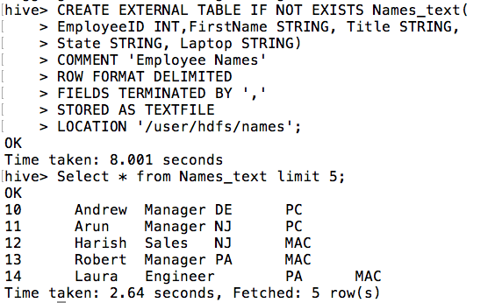
Create table from csv file

Slide 14
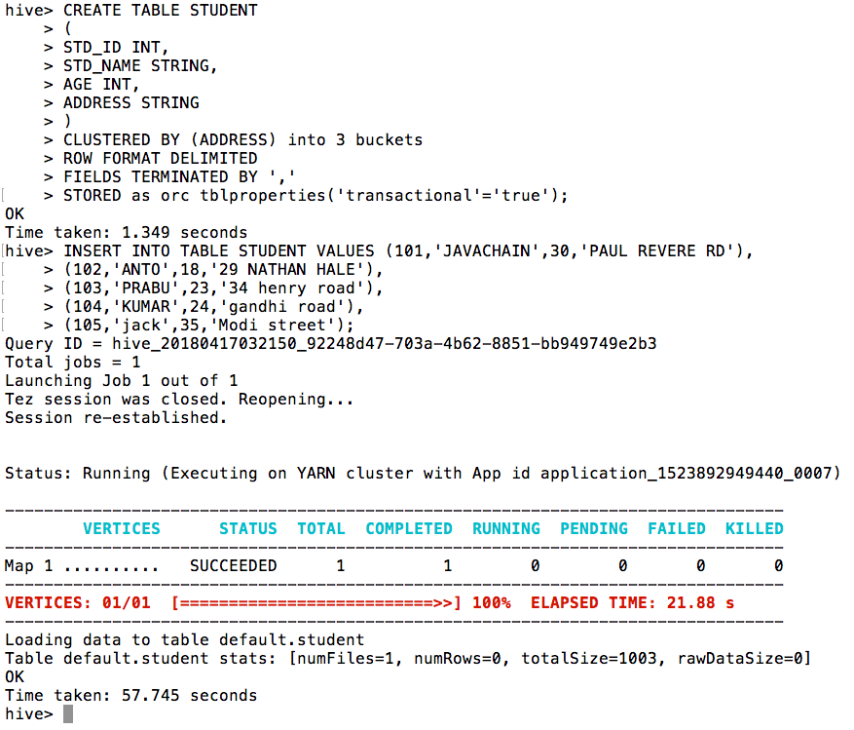
Create table manually

Slide 15
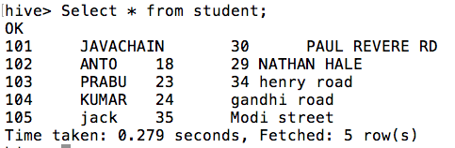
Select entry

Slide 16
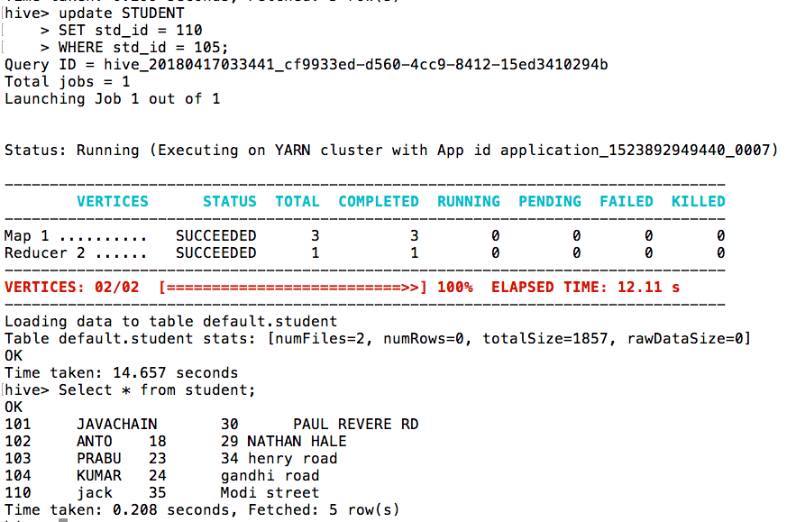
Update entry

Slide 17
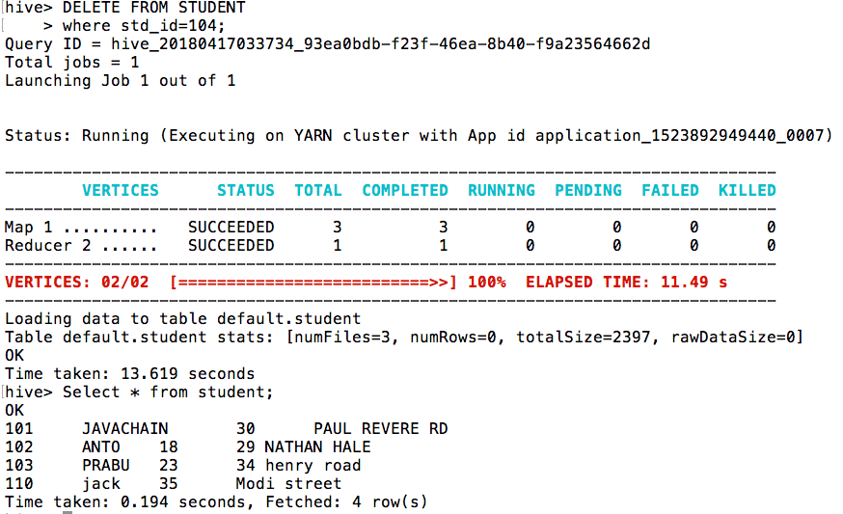
Delete entry

Slide 18
Concluding Remarks
WQD7007 Big Data Management
Hive – SQL-like scripting language for fast processing

